Slide 1
Association Football – Prediction of Team Squads and Positions
By
Anand Kamat, Deeksha Arya, Dipanjan Dutta

Slide 2
Motivation
250 million players in over 200 countries^{[1]}
Huge fan following of over 4 billion people^{[2]}
Statistics of performance of players released, but process of selection of squad confidential
Football championships give high monetary opportunities as large amounts of bets are placed worldwide on both International matches and league matches
Great amount of statistical data is studied to predict:
best player of a match/tournament
team to win a match and ultimately championship
Though of great interest, not much research has gone into predicting a playing 11 of a team
Useful especially in fantasy football or video games to generate an opponent team based on easy-medium-hard difficulty level
[1] https://en.wikipedia.org/wiki/Association_football
[2] http://www.totalsportek.com/most-popular-sports/

Slide 3
Our Plan
Set of players
Classify players as forward, midfield, defense, goalkeeper
Create plausible playing team of 11
Compute overall rank of each player

Slide 4
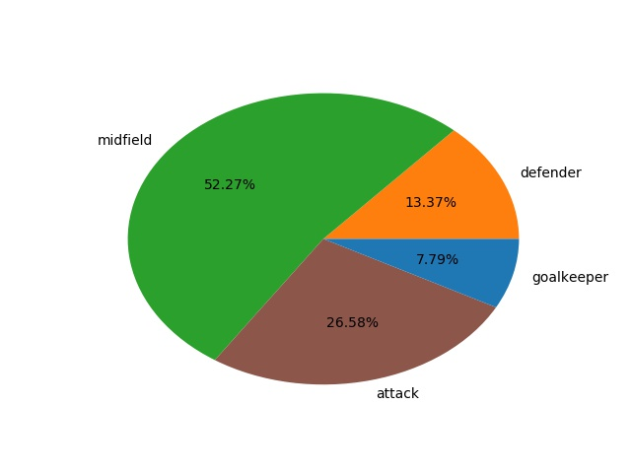
The Dataset European Soccer Database
We focus on association football in Europe
10,000+ players with information over the seasons from 2008-2016
Attributes of players sourced from EA Sports FIFA video game series as of 16th Oct 2016
Percentage of position of players in dataset

Slide 5
Step 1: Classifying Players into Position
162257 rows of player and their attributes over time
Classification task to classify a player to be played as one of 4 classes:
Attack
Midfield
Defense
GoalKeeper
34 features of each player including:
crossing, finishing, heading accuracy, short passing, volleys, dribbling, curve, free kick accuracy

Slide 6
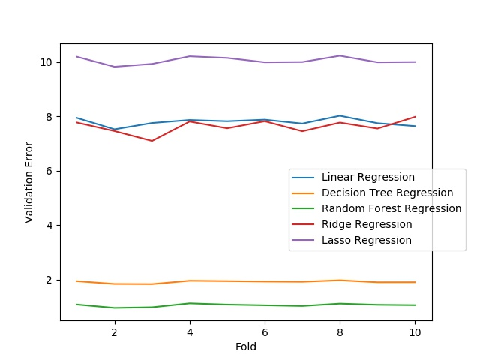
Step 2: Overall Ranking of Players
Regression task to compute overall rating of player on 100
35 features for each player including:
potential, ball control, acceleration, sprint speed, agility, reactions, balance, shot power, jumping, strength, long shots and aggression
Algorithm details:
Training: 80%
Testing: 20%
Error function:
Mean Squared Error (MSE)
MSE on Test Data using
Random Forest Regression: 0.94
10-fold cross validation
on a number of regression algorithms

Slide 7
Our Current Work
Given a set of features of multiple players, pick the best combination for the playing 11
Players chosen from:
Aaron Ramsey
Alex Iwobi
Alexandre Lacazette
Alexis Sanchez
Calum Chambers
Danny Welbeck
Francis Coquelin
Granit Xhaka
Hector Bellerin
Jack Wilshere
Laurent Koscielny
Mathieu Debuchy
Mesut Oezil
Mohamed Elneny
Nacho Monreal
Olivier Giroud
Per Mertesacker
Petr Cech
Santi Cazorla
Sead Kolasinac
Serge Gnabry
Shkodran Mustafi
Taulant Xhaka
Theo Walcott
81.6
83.1
85.8
86.4
81.1
84.4
78.7
82.9
82.4
82.0
84.3

Slide 8
Further Scope of the Project
Given a team’s composition, location of the match and home ground vs away advantage statistics, predict the likelihood of the team winning or losing to its opponent
Use sentiment from commentary data, Twitter, and news articles to better adjudge a player and his performance
Use additional features such as previous history of a team to determine the likelihood of a win

